Slide 1
Update on the Regional Workshop and overview of Japanese Research Projects
“The One Atmosphere” IGAC-SPARC Joint Workshop in Kyoto, October 25 and 26
First Observation Data from the Superconducting Submillimeter-Wave Limb-Emission Sounder (SMILES)
PANSY – Program of the Antarctic Syowa MST/IS Radar (by K. Sato)

Slide 2

“The One Atmosphere”
IGAC-SPARC Joint Workshop
Key Note:
K. Law and T. Shepherd
Aerosols and Oxidants from the Global Perspective
Interface between the Atmosphere, Biosphere, and Ocean
Stratosphere-troposphere coupling
Impacts on Climate and Earth System

Slide 3
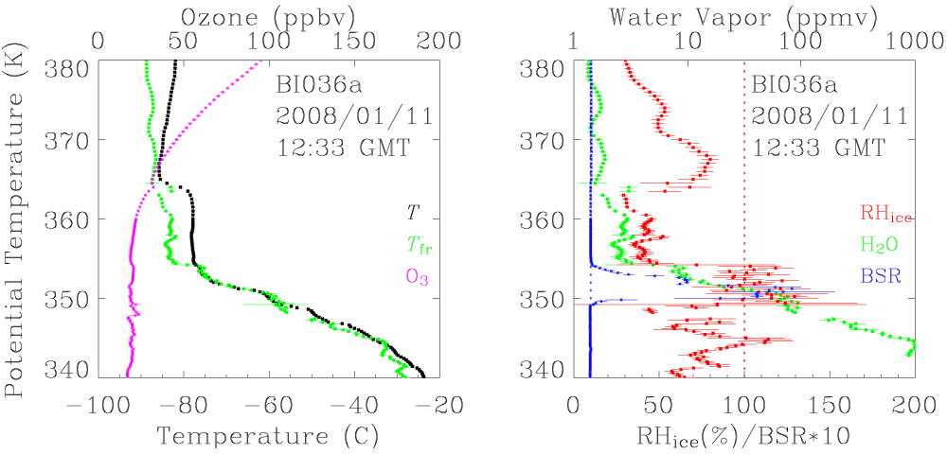
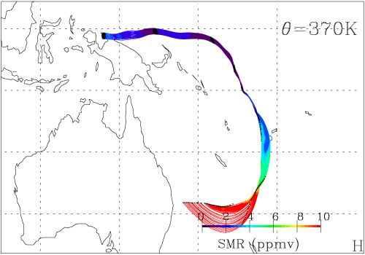
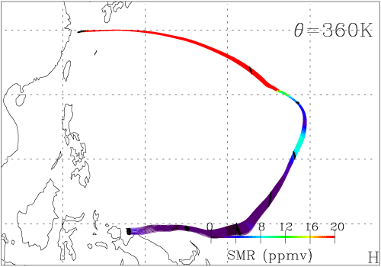
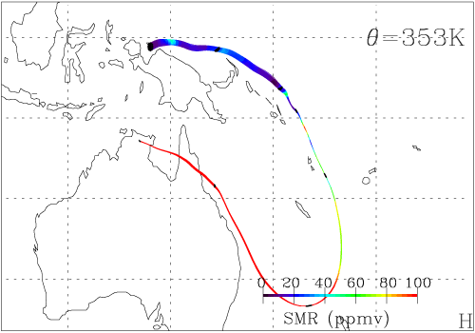
Meteorological Interpretation
Layered structure
TTL mostly covered by the air mass from S midlatitudes
Intrusion from N midlatitudes
  ‘Cold trap’ dehydration for a few days before arrival at Biak
  Warm/dry layer (356~364K)
350~354K (13.1~15.2km): Super-saturation (<25%)
  Aerosol layer (BSR_{max} 12.8; 351K) detected by Cobald/blue
  Possible hydration by deep convection (T-T_{bb} > - 20 degrees)
  Experiencing low SMR over Biak
P-15: Simultaneous observations of humidity by CFH and cirrus clouds by lidar Shibata et al.
Presented by F. Hasebe

Slide 4
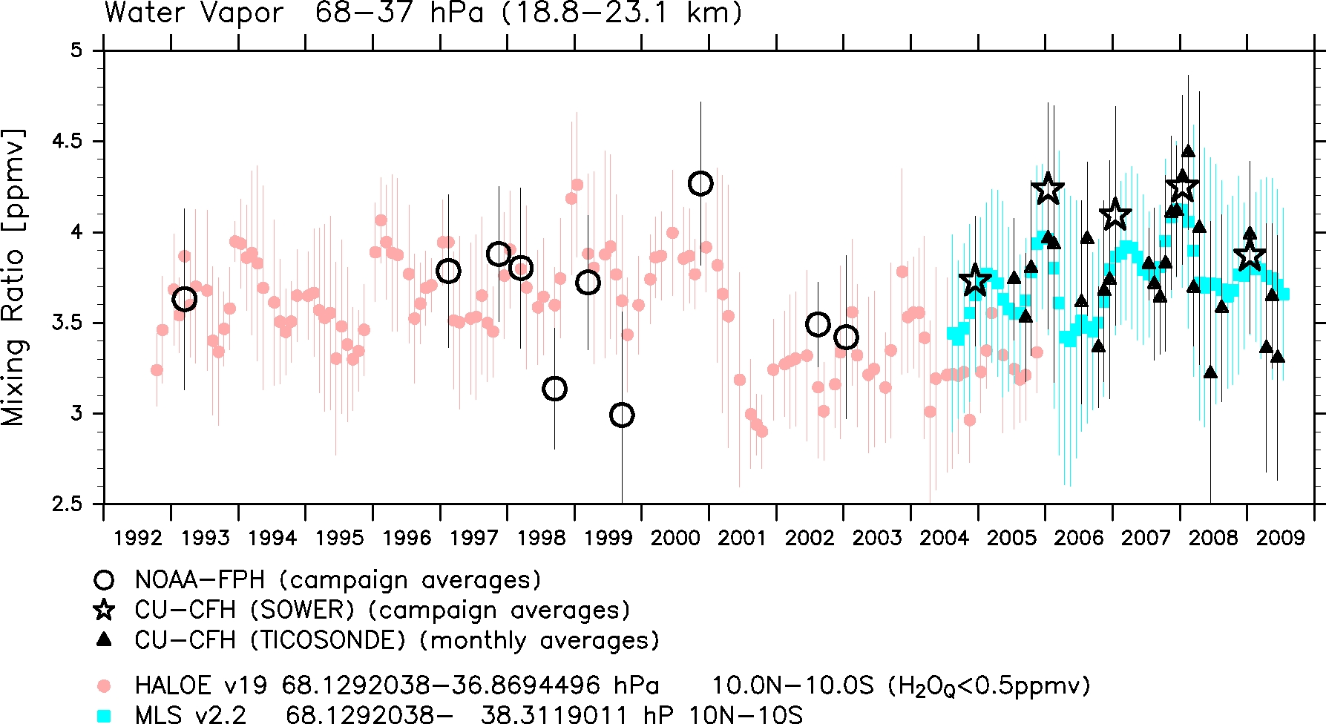
P-14: Seasonal to long-term variations of water vapor in the tropical lower stratosphere observed with balloon-borne hygrometers
Fujiwara et al.
The 1990s: a gradual increase from ~3.6 to ~4 ppmv (~3 ppmv in September)
From 2000 to 2002-2003: a drop
After 2004: returned to the numbers in the late 1990s → Decadal Variations !
MLS and CFHs generally agree well; annual and QBO amplitudes greater for CFHs
HALOE is about 0.5 ppmv lower than MLS and CFHs in 2004-2005.
Notes:
4

Slide 5
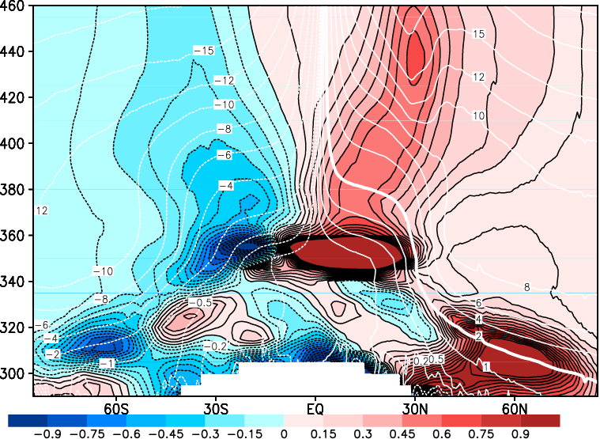
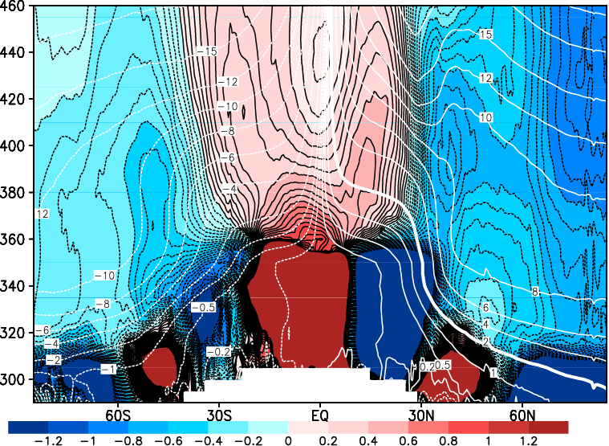
Presented by Y. Miyazaki
Mean-meridional circulation: January
Mean meridional wind V*
Mean vertical wind W*
4PVU
Compared to a coarse resolution model, the high resolution model has
・stronger convergence of the mean downward velocity in the lowermost stratosphere
・stronger and sharper meridional divergent flows in both the tropical Hadley circulation and the extratropical direct circulation

Slide 6
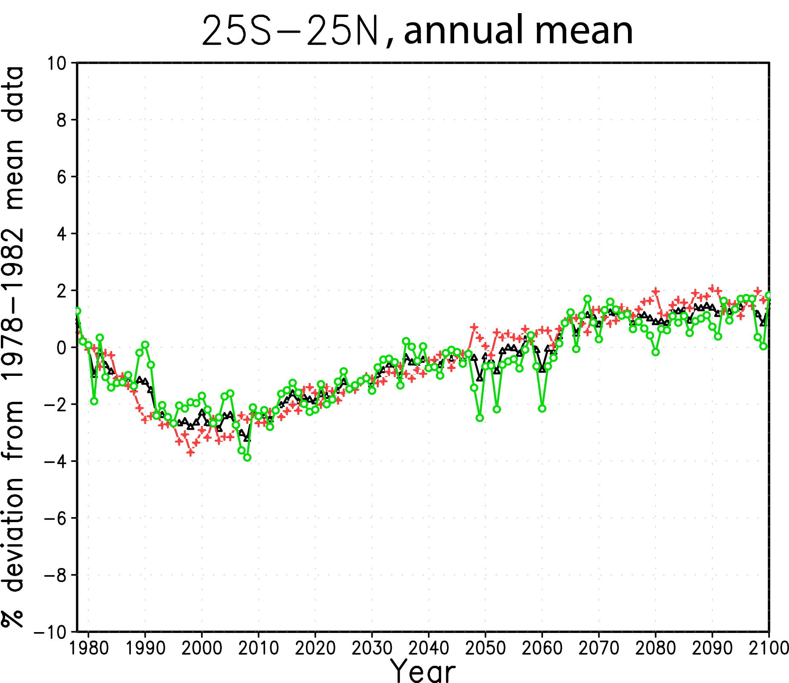
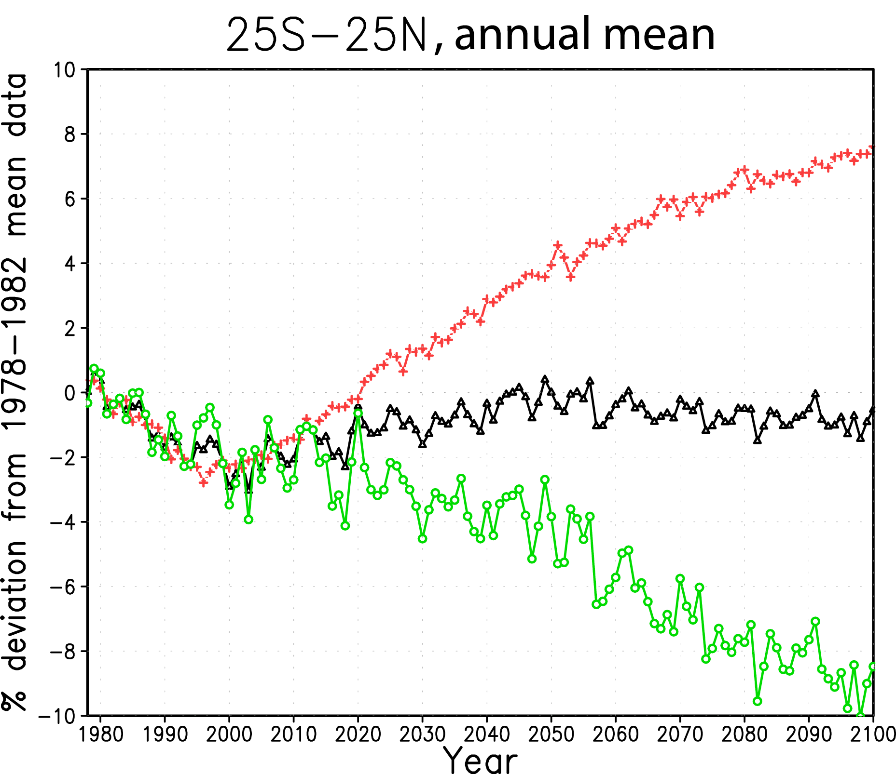
Column ozone deviation in the tropics
Presented by H. Akiyoshi
REF2
NCC
black：total ozone deviation, red：column ozone above 20hPa, green：column ozone below 20 hPa, CCMVal-1, CCSR/NIES

