Slide 1
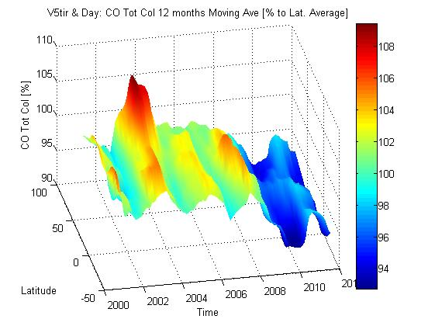
MOPITT V5 TIR day
The surface plot of the ratio of seasonal removed CO total Column,
(by 12 months running average) to the CO total Column -Latitudinal Average
(average over entire MOPITT mission).

